Slide 1



Presentation XII
Bone Tissue Phantom
Thu Ta Zaw
2415121095

Slide 2

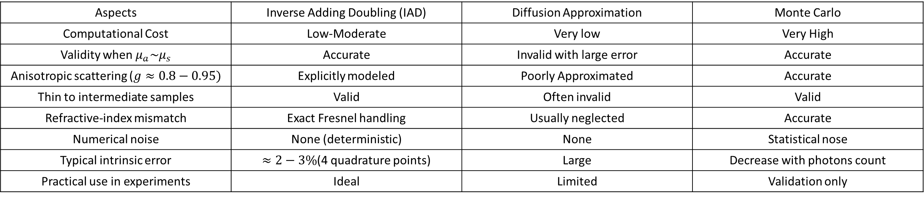
Simulations comparison
Advantages of Inverse-Adding Doubling Method
IAD combines near-Monte-Carlo accuracy with computational efficiency, without the validity limits of diffusion methods.
Aspects | Inverse Adding Doubling (IAD) | Diffusion Approximation | Monte Carlo
Computational Cost | Low-Moderate | Very low | Very High
Validity when $μ_{a}\sim μ_{s}$ | Accurate | Invalid with large error | Accurate
Anisotropic scattering ($g≈0.8−0.95)$ | Explicitly modeled | Poorly Approximated | Accurate
Thin to intermediate samples | Valid | Often invalid | Valid
Refractive-index mismatch | Exact Fresnel handling | Usually neglected | Accurate
Numerical noise | None (deterministic) | None | Statistical nose
Typical intrinsic error | $≈2−3\%$(4 quadrature points) | Large | Decrease with photons count
Practical use in experiments | Ideal | Limited | Validation only
IAD achieves Monte-Carlo-level accuracy with diffusion-like efficiency, without restrictive assumptions.
IAD is faster for inverse problems than MC. It is deterministic and noise-free while MC requires very large photon counts. It has no statistical uncertainty in forward model and well suited for optimization loops.
Determination of the optical properties of turbid media by using the adding-doubling method by Scott A. Prahl.

Slide 3
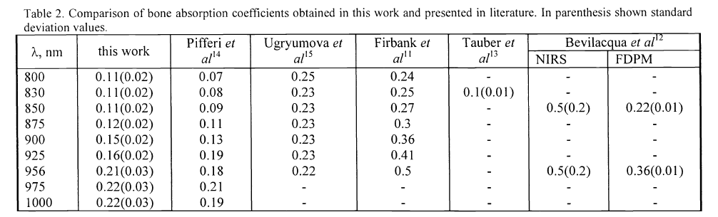
Optical properties of bone
Measurement of optical properties of Human cranial cortical bone
Quantitatively determined the absorption and reduced scattering coefficient of human cranial cortical bone over 800-2000 nm, using spectrophotometer with integrating sphere to measure the reflectance and transmittance and IAD method to calculate the absorption and reduced scattering coefficients.
Table. Comparison of bone absorption coefficients obtained in this work and presented in literature. In parenthesis shown standard deviation

Slide 4
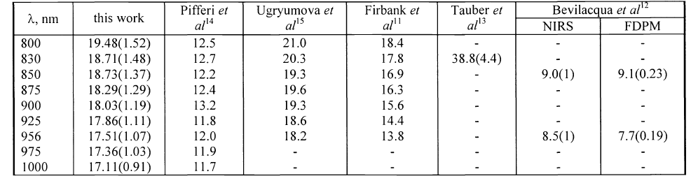
Optical properties of bone
Measurement of optical properties of Human cranial cortical bone
Table. Comparison of bone scattering coefficients obtained in this work and presented in literature. In parenthesis shown standard deviation
Optical properties of human cranial bone in the spectral range from 800 to 2000 nm by A. N. Bashkatov

Slide 5
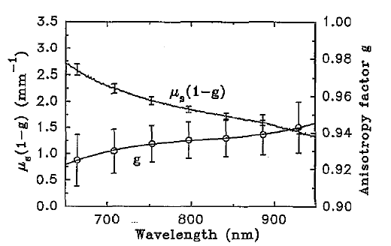
Optical properties of bone
Measurement of optical properties of pig skull
Characterized the pig skull optical properties in the NIR range by combining direct phase-function measurements, reflectance and transmittance measurement using integrating sphere and Monte Carlo inversion method.
Fig. Average of the reduced scattering coefficient and anisotropy factor of skull from measurements on six samples, error bars +-1 SD.

Slide 6
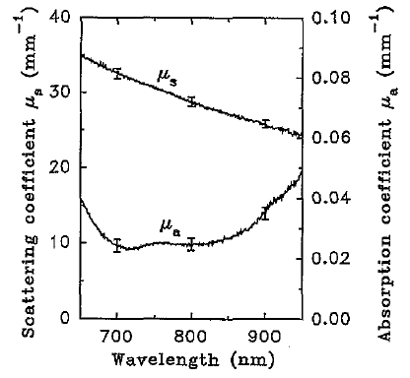
Optical properties of bone
Measurement of optical properties of pig skull
Fig. Average of the scattering coefficient and absorption coefficient of skull from measurements on six samples, error bars +-1 SD.
Measurement of the optical properties of the skull in the wavelength range 650-950 nm by M. Firbank.

Slide 7
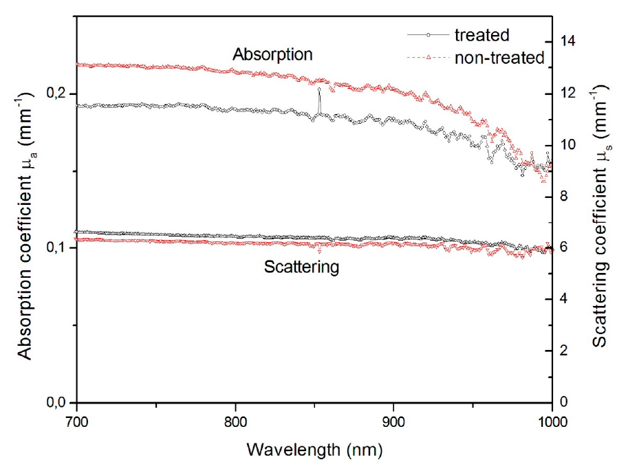
Optical properties of bone
Measurement of optical properties of bone
Quantify how demineralization alters bone optical properties using NIR spectroscopy (700-1000 nm).
Confirms bone mineral content strongly governs NIR optical behavior by using integrating sphere measurements and IAD.
Fig. Average optical properties (scattering and absorption coefficients) measured on samples analyzed
Optical properties on Bone Analysis: An Approach to Biomaterials by Andrea Antunes.

Slide 8
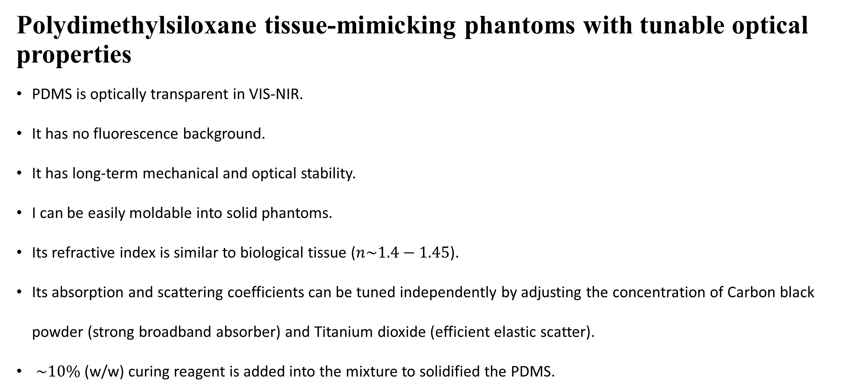
Bone tissue Phantom
Polydimethylsiloxane tissue-mimicking phantoms with tunable optical properties
PDMS is optically transparent in VIS-NIR.
It has no fluorescence background.
It has long-term mechanical and optical stability.
I can be easily moldable into solid phantoms.
Its refractive index is similar to biological tissue ($n\sim 1.4−1.45$).
Its absorption and scattering coefficients can be tuned independently by adjusting the concentration of Carbon black powder (strong broadband absorber) and Titanium dioxide (efficient elastic scatter).
$\sim 10\%$(w/w) curing reagent is added into the mixture to solidified the PDMS.
A step-by-step phantom fabrication procedure

Slide 9
Thesis Title
Optical Property-Based Selection of Human Bone Phantoms at 850 nm Using Integrating Sphere Measurements and the Inverse Adding-Doubling Method.
Aims and objectives
To experimentally acquire diffuse reflectance and transmittance data of bone phantoms at 850 nm using an integrating sphere.
To extract intrinsic optical parameters (μₐ and μₛ′) via Inverse Adding-Doubling inversion.
To establish an optical matching criterion by quantitatively comparing phantom parameters with human leg bone optical properties.
To select the most optically equivalent phantom for subsequent biomedical optical applications.
Notes:
Bone powder composite material
PLA bone phantom

Slide 10
Thesis Title
Optical Property-Based Selection of Human Bone Phantoms at 850 nm Using Integrating Sphere Measurements and the Inverse Adding-Doubling Method.
Scopes
To study the optical characterization at a single wavelength of 850nm in the near-infrared NIR region
To perform optical measurements at steady-state.
To investigate the intrinsic optical parameters (Absorption coefficient and reduced scattering coefficient) of the bone phantom.
To measure the diffuse reflectance (R) and total transmittance (T) are measured using a single integrating sphere system.

Slide 11
Thesis Title
Optical Property-Based Selection of Human Bone Phantoms at 850 nm Using Integrating Sphere Measurements and the Inverse Adding-Doubling Method.
Scopes
To Calibrate the optical measurement system using the reference standards.
To perform the background and dark signal correction for the detector.
To perform measurement on the thickness-controlled phantom samples.
To compare the intrinsic optical properties of bone tissue phantoms with published human bone studies values.
To select the suitable bone phantoms for the human bone optical studies.

Slide 12
Thesis Title
Optical Property-Based Selection of Human Bone Phantoms at 850 nm Using Integrating Sphere Measurements and the Inverse Adding-Doubling Method.
Significance of the Study
Improves the reliability of bone phantom selection through quantitative optical-property matching rather than assumption-based design approaches.
Enables the development of optically equivalent bone phantoms for controlled biomedical optical experiments at 850 nm.
Provides reusable, stable, and tunable phantom materials, ensuring consistent experimental conditions and repeatability.
Reduces dependence on real human bone samples, supporting ethical research practices and improving experimental accessibility.

Slide 13
The End
THANK YOU FOR LISTENING
Thu Ta Zaw
2415121095

